Slide 1

SQL Server

Slide 2
Overview of material
Databases
Design – entity-relationship modelling
Setting up a database in SQL Server Management Studio
SQL database queries
Coding with LINQ
Software development lifecycle
Coding standards
Project ideas

Slide 3
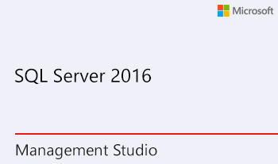

https://www.microsoft.com/en-gb/sql-server/sql-server-editions-express

Slide 4
Installing and Configuring SQL Server 2016 Express

Slide 5
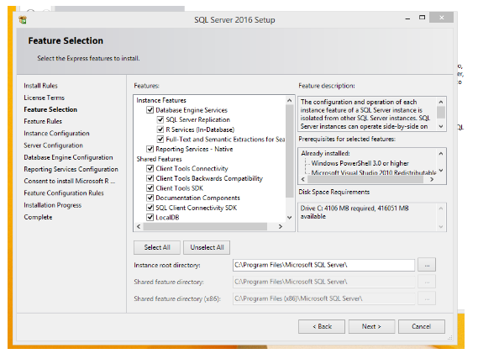
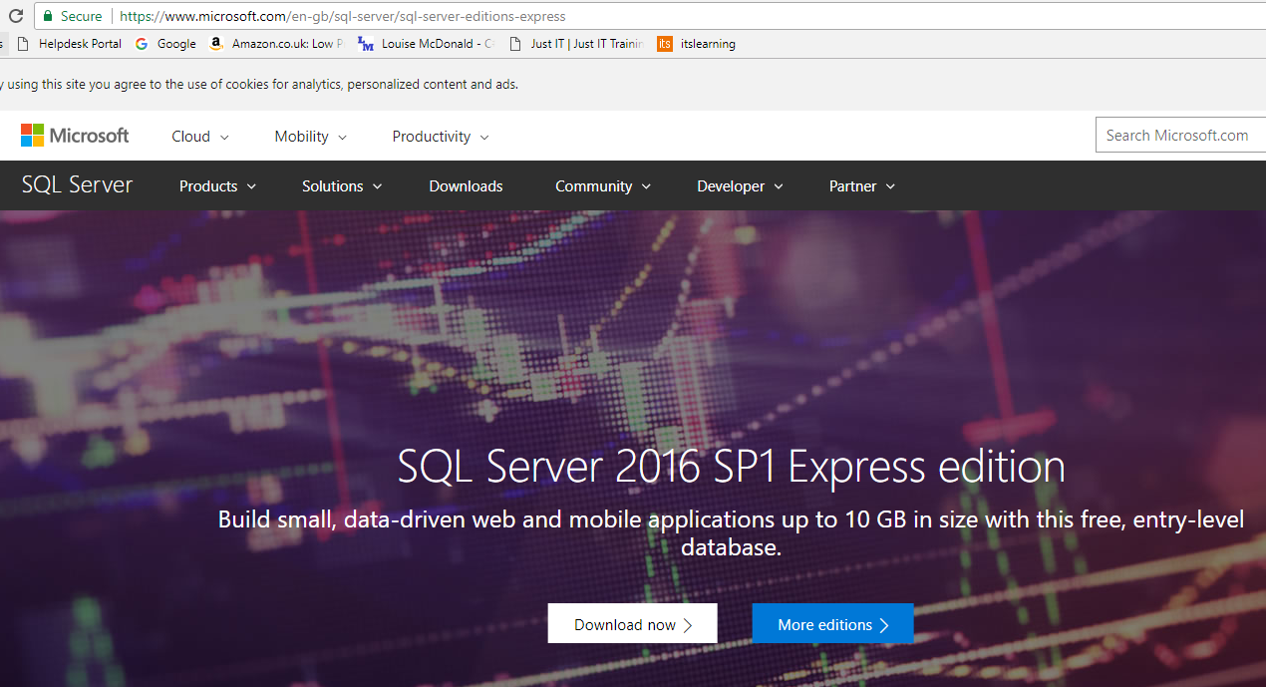
Installation of SQL Server Express 2016
Remove any older versions of SQL Server and SQL Server Management Studio from your computer
See slides at end for instructions
Do a custom installation of SQL Server Express 2016
https://www.microsoft.com/en-gb/sql-server/sql-server-editions-express
If you get the choice, select LocalDB during the installation process

Slide 6
Installing and Configuring SSMS
SQL Server Management Studio

Slide 7
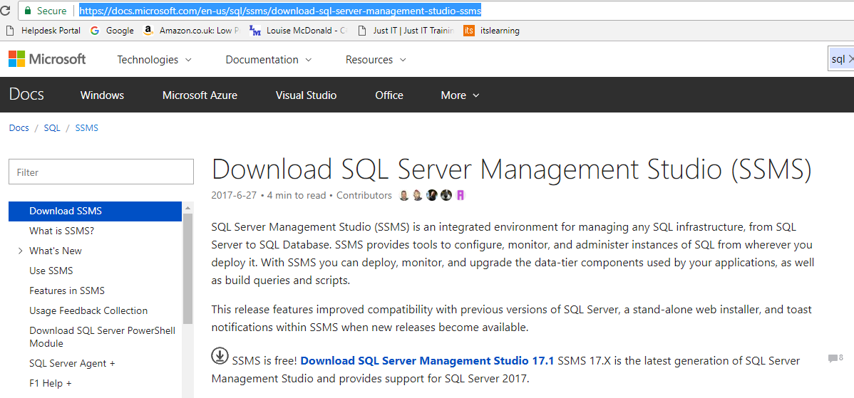
Installation of SQL Server Express 2016
Install SQL Server Management Studio 2017
https://docs.microsoft.com/en-us/sql/ssms/download-sql-server-management-studio-ssms
This may be quick or can take well over an hour

Slide 8
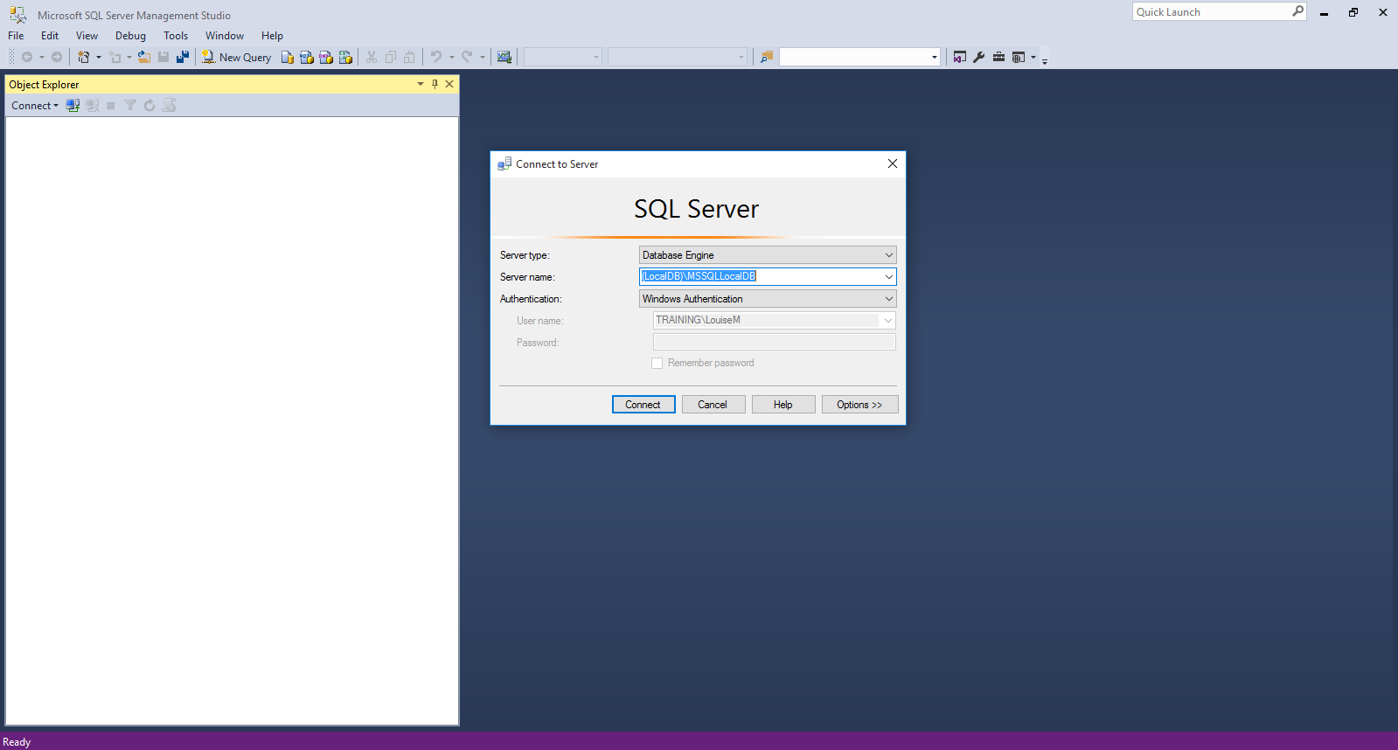
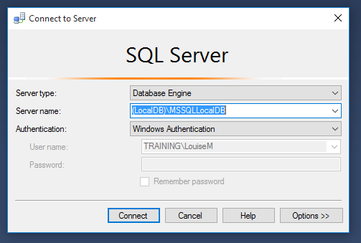
Logging into SQL Server Management Studio
Type this in if it isn’t in the list of options and make sure Windows Authentication is selected
If you get an error here, you may also need to run sqllocaldb at the command prompt to start MSSQLLocalDB
See instructions at the end of the slides

Slide 9
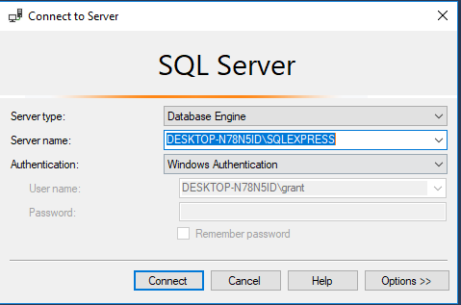

Slide 10
Troubleshootnig

Slide 11
SQL Server and SQL Server Management Studio installation – errors and troubleshooting

Slide 12
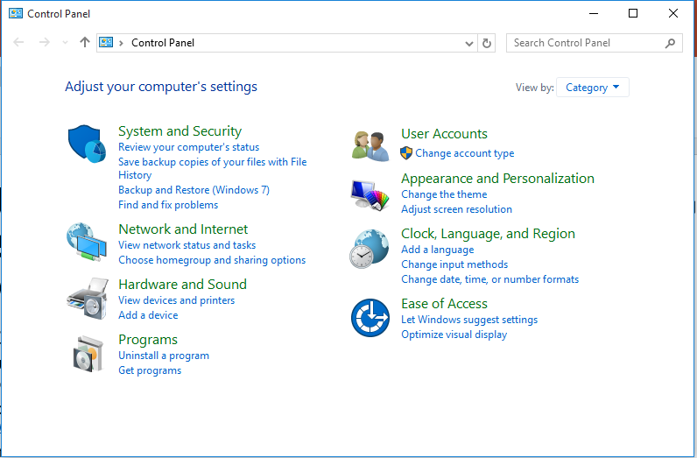
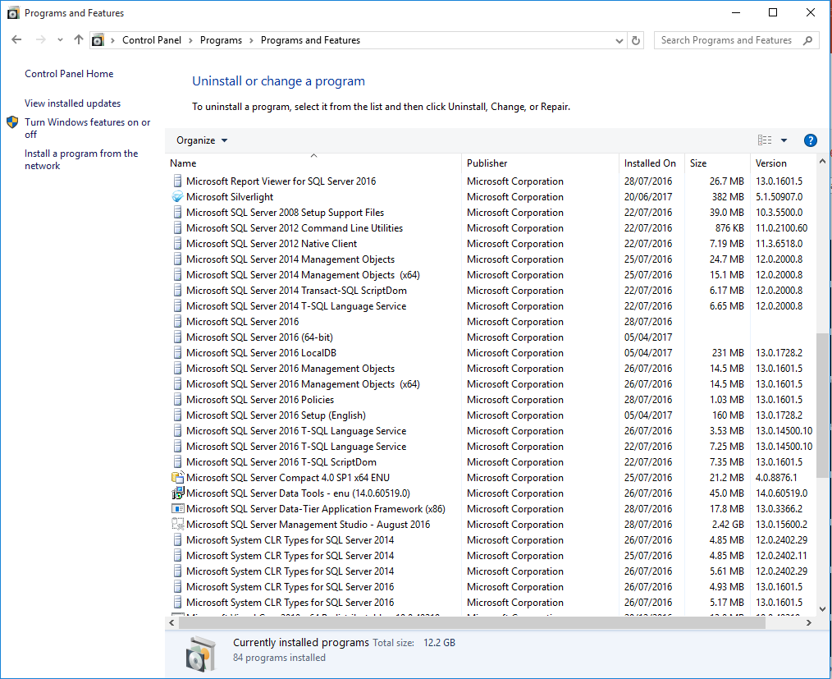
How to remove an old version of SQL Server or SQL Server Management Studio
Before installing a new version of SQL Server or SQL Server Management Studio
You MUST remove any old versions
If you don’t, the new installation may fail
Go to the control panel
To get there, type Control Panel into the Windows search box
Choose Uninstall a Program
For every file beginning with Microsoft SQL Server
Right-click and select Uninstall
BUT if you get a warning about dependencies, don’t go ahead with uninstalling that file
When you have gone through the list once
Press F5 to refresh the list
Uninstall any remaining files beginning with Microsoft SQL Server
BUT if you get a warning about dependencies, don’t go ahead with uninstalling that file
Go through the list again if there are any relevant files left
When there are no files left that begin with Microsoft SQL Server, you are finished and you can install the new versions of SQL Server and SQL Server Management Studio

Slide 13
If you get an error logging into SQL Server Management Studio using LocalDB – 1/2
LocalDB is the best database to use with SQL Server Management Studio
It is easy to deploy
It doesn’t need IIS
If you get an error trying to log in to SQL Server Management Studio using LocalDB you need to run the sqllocaldb utility to fix the problem
This should be included in your SQL Server Express download
To check if you have it, go to the Command Prompt and type sqllocaldb
If it’s not there, you will get an error message saying it wasn’t found
If you don’t have it, ask one of the trainers if they have a copy
Go to the Command Prompt
To find it, type Command Prompt into the Windows search box

Slide 14
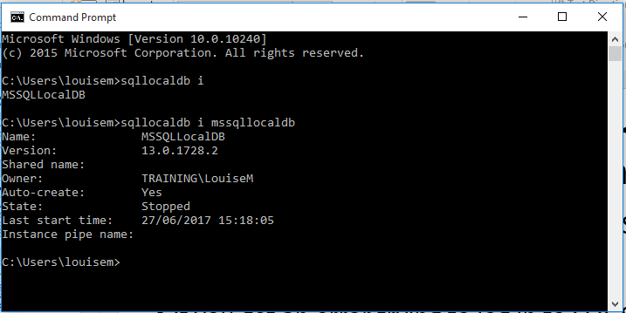
If you get an error logging into SQL Server Management Studio using LocalDB – 2/2
At the Command Prompt
Type sqllocaldb i to find out which databases you have
Type sqllocaldb i mssqllocaldb to get information about mssqllocaldb
If the information shows as on the right, type sqllocaldb start mssqllocaldb and try starting SQL Server Management Studio again and logging in with LocalDB
If there is an error and this information doesn’t display
Type sqllocaldb delete mssqllocaldb
Warning: this will delete all your existing databases, so back them up first
Type sqllocaldb create mssqllocaldb
Try starting SQL Server Management Studio again and logging in with LocalDB

Slide 15
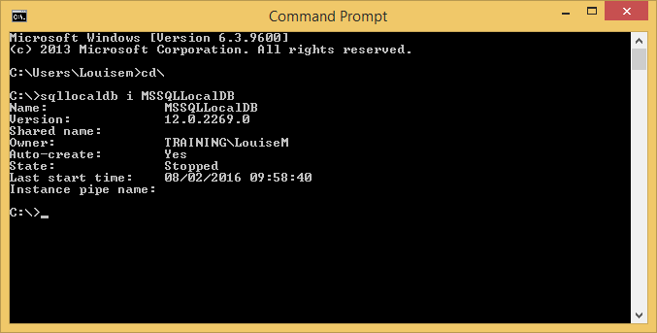
Getting MSSQLLocalDB running after installing SQL Server 2014
MSSQLLocalDB is the new name for the LocalDB accessed through SQL Server Management Studio. You
will need it for any database applications created using the DatabaseFirst approach.
Run sqllocaldb as in the screenshot below to check whether the DB is running
If sqllocaldb doesn’t run, search for sqllocaldb in Windows Explorer
Click on sqllocaldb and run the installer
Then run sqllocaldb as in the screenshot below
This will soon be updated
to SQL Server 2016 – the
main difference is that the
local DB is version 13
Note that Db is stopped –
should be State: Running

Slide 16
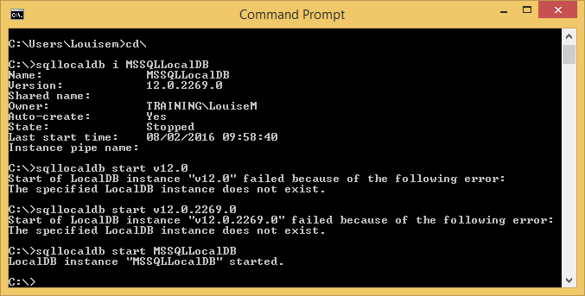
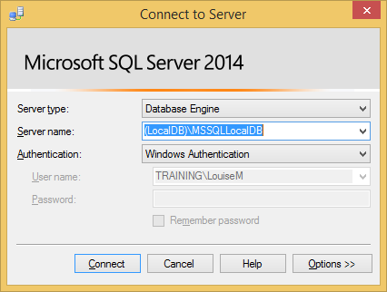
You will see the message above if the LocalDB has
been started correctly.
Now log in to SQL Server Management Studio like this
Type this in!!!

Slide 17
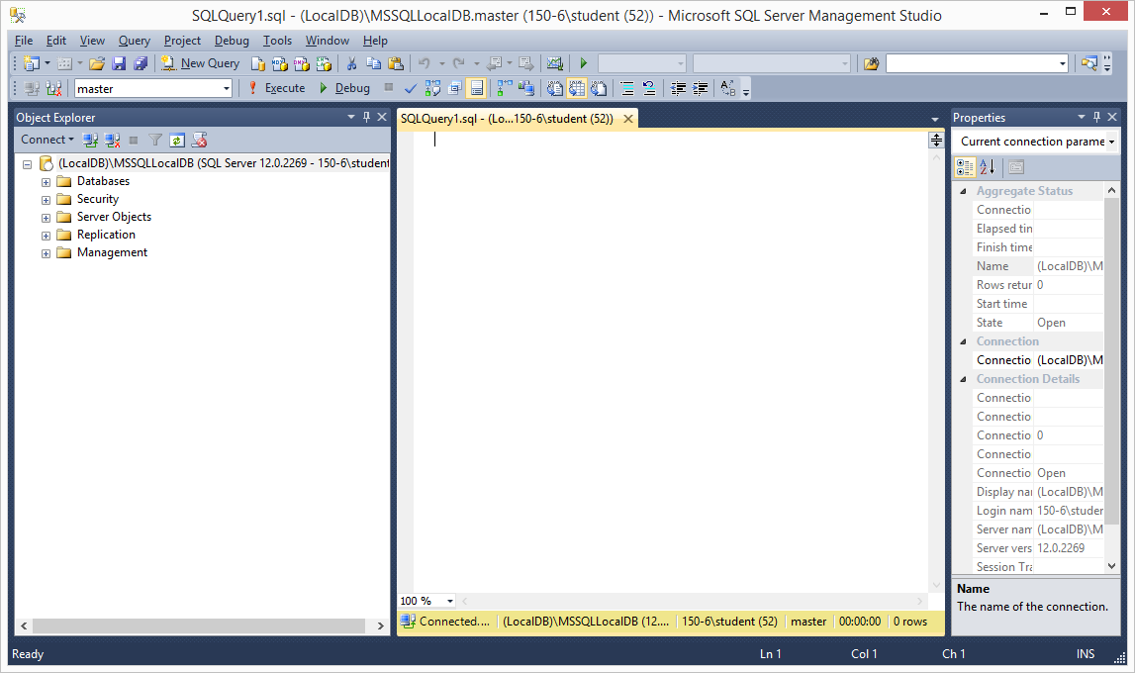
SQL Server Management Studio 2016 (Express) Bug
Louise
12 July 2016
There is a known bug in SQL Server Management Studio 2016 (Express), where some menu options don’t appear. This has included the backup option, creating a new table, editing rows and probably some others, as it seems to vary between machines.
The bug has been reported to Microsoft and it’s reasonable to assume that they are working on a fix.
While we wait for that, I think the best workaround is to use the SQL language to perform the missing functions. (The functionality is still there in the software – only the menu options are missing.)
To use the SQL language, click on the New Query button and a window will open:
You can type your query into this window. After typing your query, click the button with the red exclamation mark to execute it. Then check in the Object Explorer (refresh if necessary) to make sure you got the results you expect.
Here are some example queries for important SQL functions. I won’t include all the options – just enough to replicate the missing menu options.
I’ve put names of databases, tables and columns in italics.
DON’T USE SPACES IN NAMES OF DATABASES, TABLES OR COLUMNS!!!!!

Slide 18
Function | Query
Creating a database | CREATE DATABASE Database Name e.g. CREATE DATABASE Library
Adding a table | USE Database Name CREATE TABLE TableName (ColumnName DataType IDENTITY NULL or NOT NULL, Repeat the above line for each column (though only the primary key will have IDENTITY) and finish with a closing round bracket ) e.g. USE Library CREATE TABLE Book ( ID int IDENTITY NOT NULL, Title varchar(50) NOT NULL, Author varchar(50) NOT NULL, ISBN varchar(50) NULL, Price decimal(18,2) NULL )

Slide 19
Function | Query
Creating a database | CREATE DATABASE Database Name e.g. CREATE DATABASE Library
Adding data to a table | INSERT INTO TableName (ColumnName1, ColumnName2, etc.) VALUES (‘ValueForColumn1’, ValueForColumn2, etc.), Repeat the above line for each set of values, putting single quotes around anything that isn’t a number. End the last line with a semi-colon instead of a comma. Note that you don’t have to enter data for the ID field. e.g. INSERT INTO Book (Title, Author, ISBN, Price) VALUES ('Ready Player One','Ernest Cline','11111', 7.99), ('Demon Haunted World', 'Carl Sagan', '22222', 8.99);

Slide 20
Backing up a database | USE Database Name GO BACKUP DATABASE Database Name TO DISK ‘path and filename’ e.g. USE Library; GO BACKUP DATABASE Library TO DISK = 'C:\Users\Student\Library.Bak'
Restoring a database | RESTORE DATABASE Database Name FROM DISK ‘path and filename’ e.g. RESTORE DATABASE Library FROM DISK = 'C:\Users\student\Library.bak'; Before restoring a database, make sure it isn’t already open in SQL Server Management Studio. You may have to go into Task Manager in Windows to close the file if SQL Server Management Studio hasn’t closed it properly.
NB: SQL commands are not case-sensitive, but there is a longstanding convention that keywords are in capitals. If you stick to this, your database code will be more readable.

Slide 21
SSMS

Slide 22
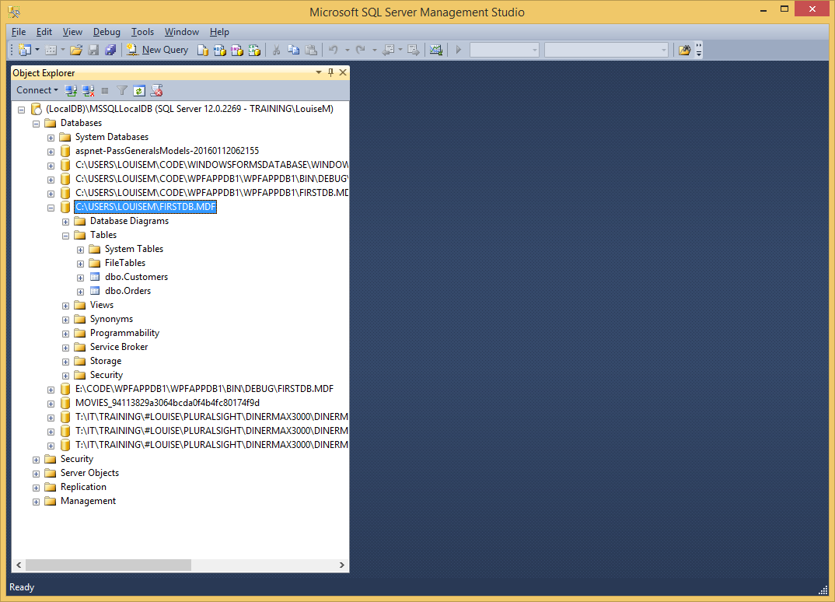
Databases – SQL Server Management Studio

Slide 23
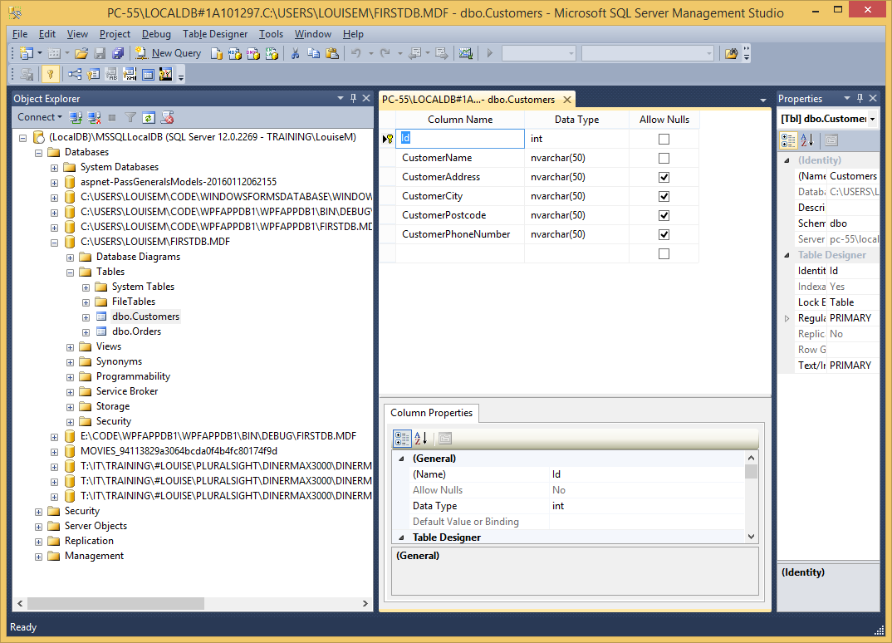
SSMS – table design

Slide 24
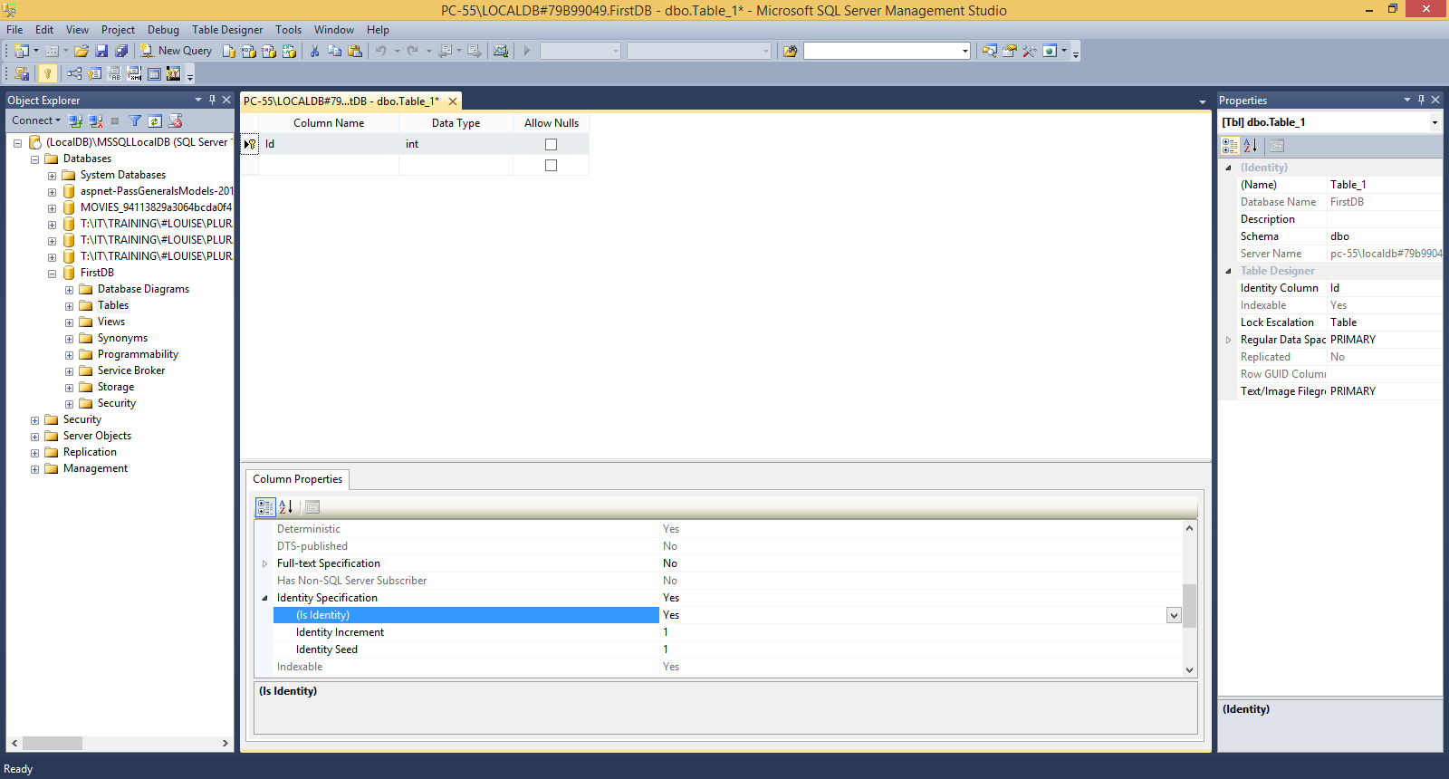
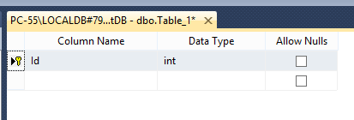
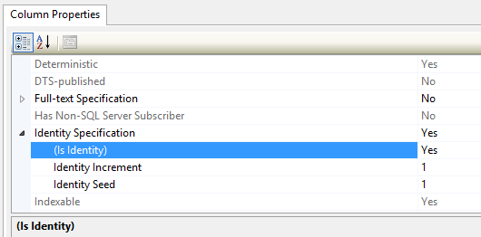
Databases – setting up your primary key

Slide 25
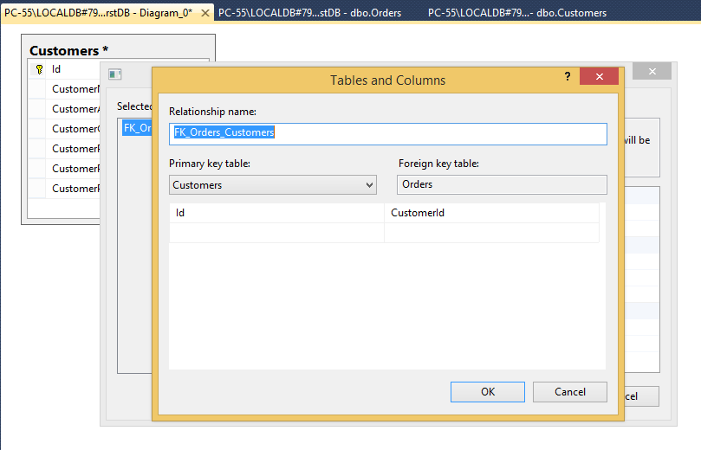
Databases – setting up your primary key

Slide 26
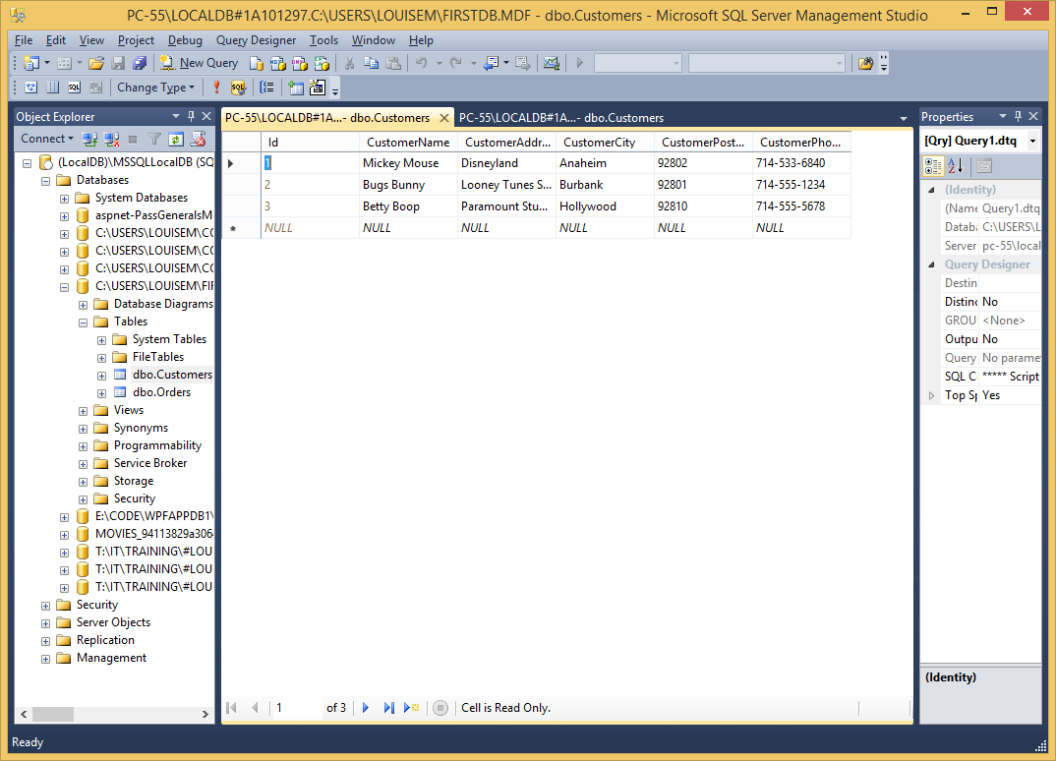
SSMS – table data

Slide 27
ADO.Net

Slide 28
ADO.NET Entity Framework
Entity framework is an Object/Relational Mapping (O/RM) framework
It is an enhancement to ADO.NET that gives developers an automated mechanism for accessing and storing data in the database
Easy to use and saves a lot of work
Can be set up in Visual Studio

Slide 29
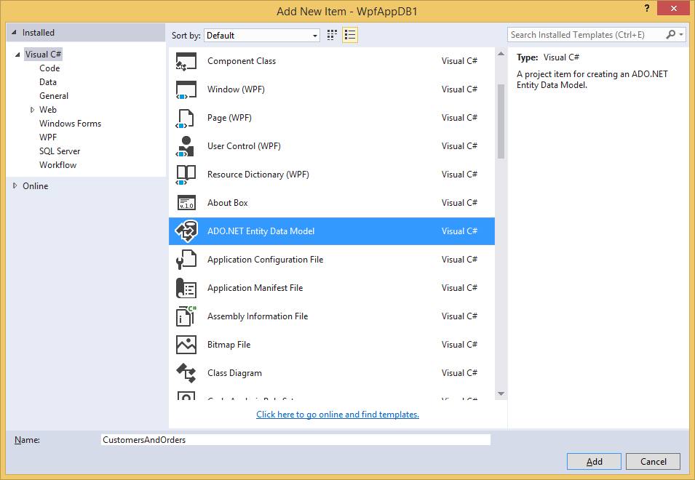
Adding an ADO.NET Entity Data Model
Start a new project in MVC
Empty, then add MVC folders and core references is a good option
Right-click on the Models folder
Select Add New Item
Select ADO.NET Entity Data Model (either from that menu or from the dialog shown here)
No need to change the model name

Slide 30
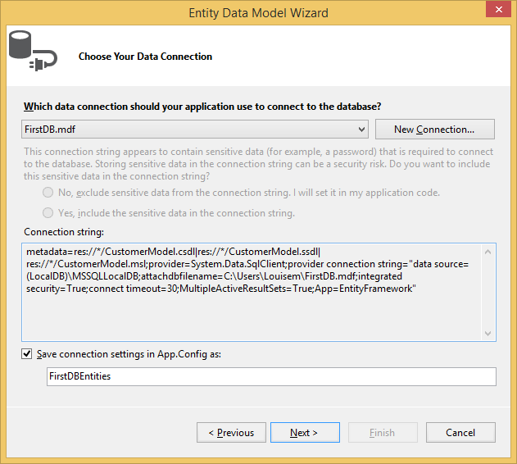
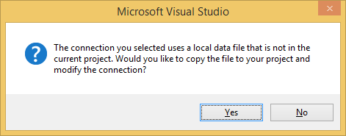

Slide 31
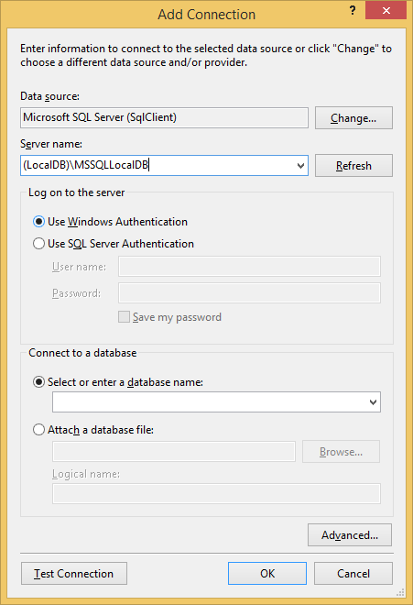
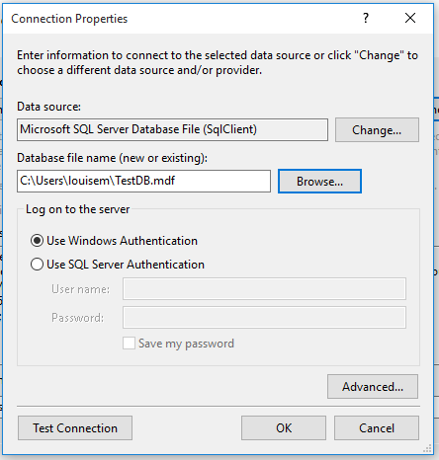
Two options for connecting to a DB here – try the one below first
Same DB as we used to
log in to SSMS
Put the DB filename here
Then click Test Connection – if you get a green tick, then click OK

Slide 32
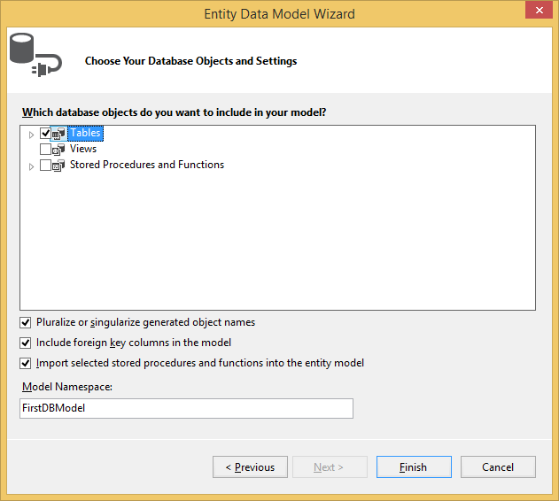
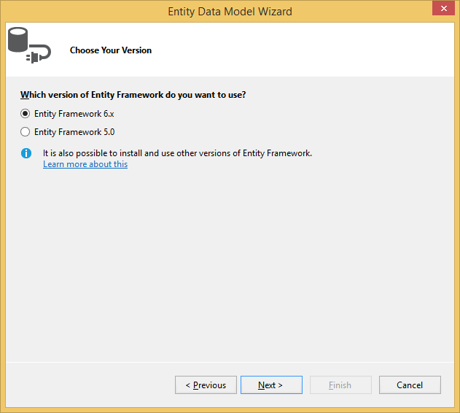
You MUST select this, otherwise there will be no data in your model

Slide 33
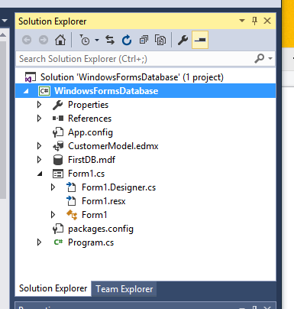
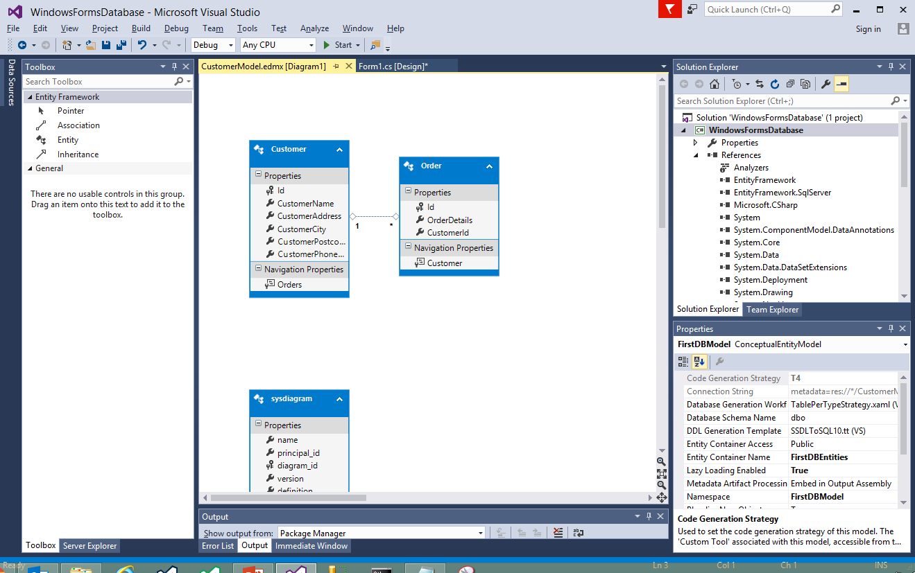
ADO.NET EF model in Visual Studio

Slide 34
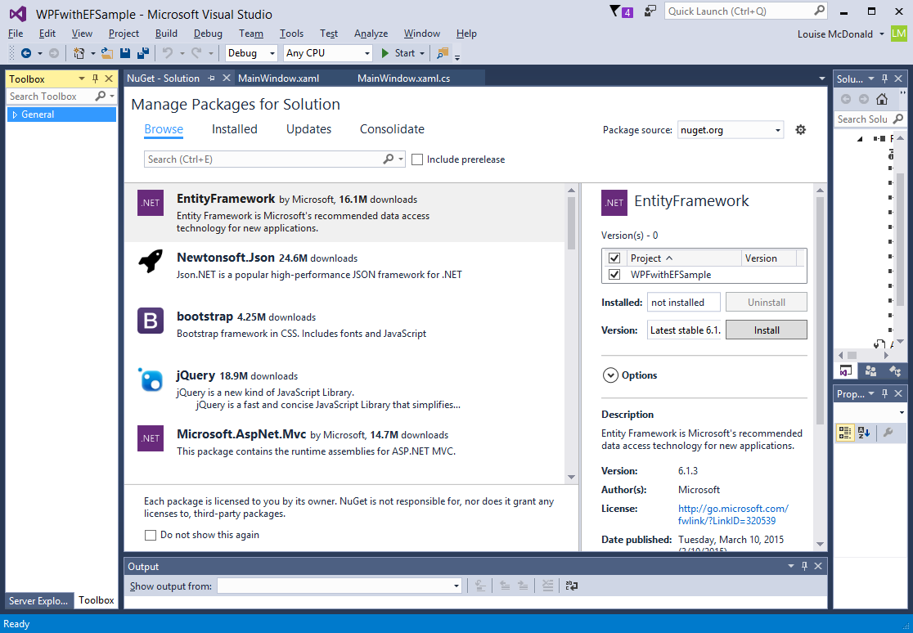
Entity Framework
ADO.NET should install this automatically, but it’s work checking the references to make sure
If you need to install it, go to the Tools menu and select the NuGet Package Manager
Click Browse and type in Entity Framework
Select Entity Framework on the left of the screen
On the right of the screen, check the box next to your project
Click install and wait until you see a message in the Output window saying that the installation has been successful
The NuGet Package Manager can also be used to install other useful packages, e.g. Bootstrap

